Slide 1
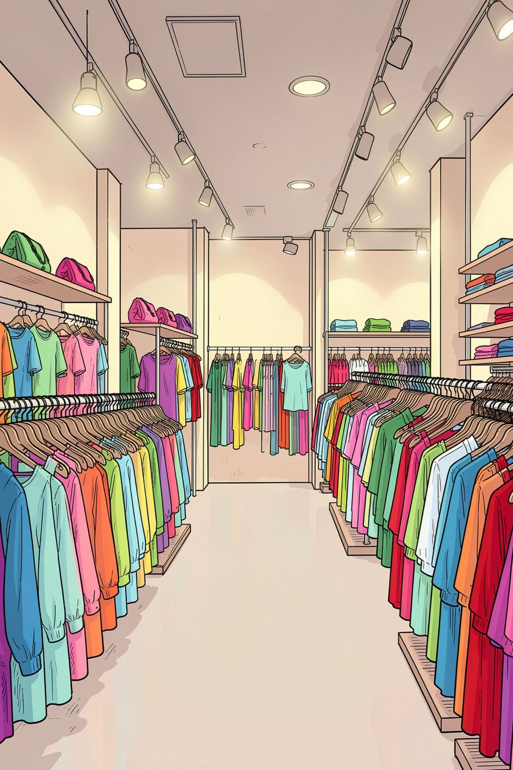
Customer Shopping Behavior Analysis
Uncovering insights from 3,900 purchases to guide strategic business decisions — from gender-based revenue patterns to subscription impact and customer segmentation.

Slide 2

Dataset Overview
3,900
18
Total Purchases
Data Columns
Comprehensive transaction records spanning customer demographics and behavior
Rich attributes covering purchase details, shipping, and customer profiles
37
Missing Values
Concentrated exclusively in the Review Rating column — minimal data quality impact

Slide 3

Data Preparation Process
Missing Data Handling
Data Loading
Imported dataset using pandas
Imputed Review Rating with median
Initial Exploration
Feature Engineering
Checked structure and summary stats
Created age groups and frequency
A structured pipeline ensured data integrity before analysis — from raw import through feature creation and database integration for repeatable querying.

Slide 4
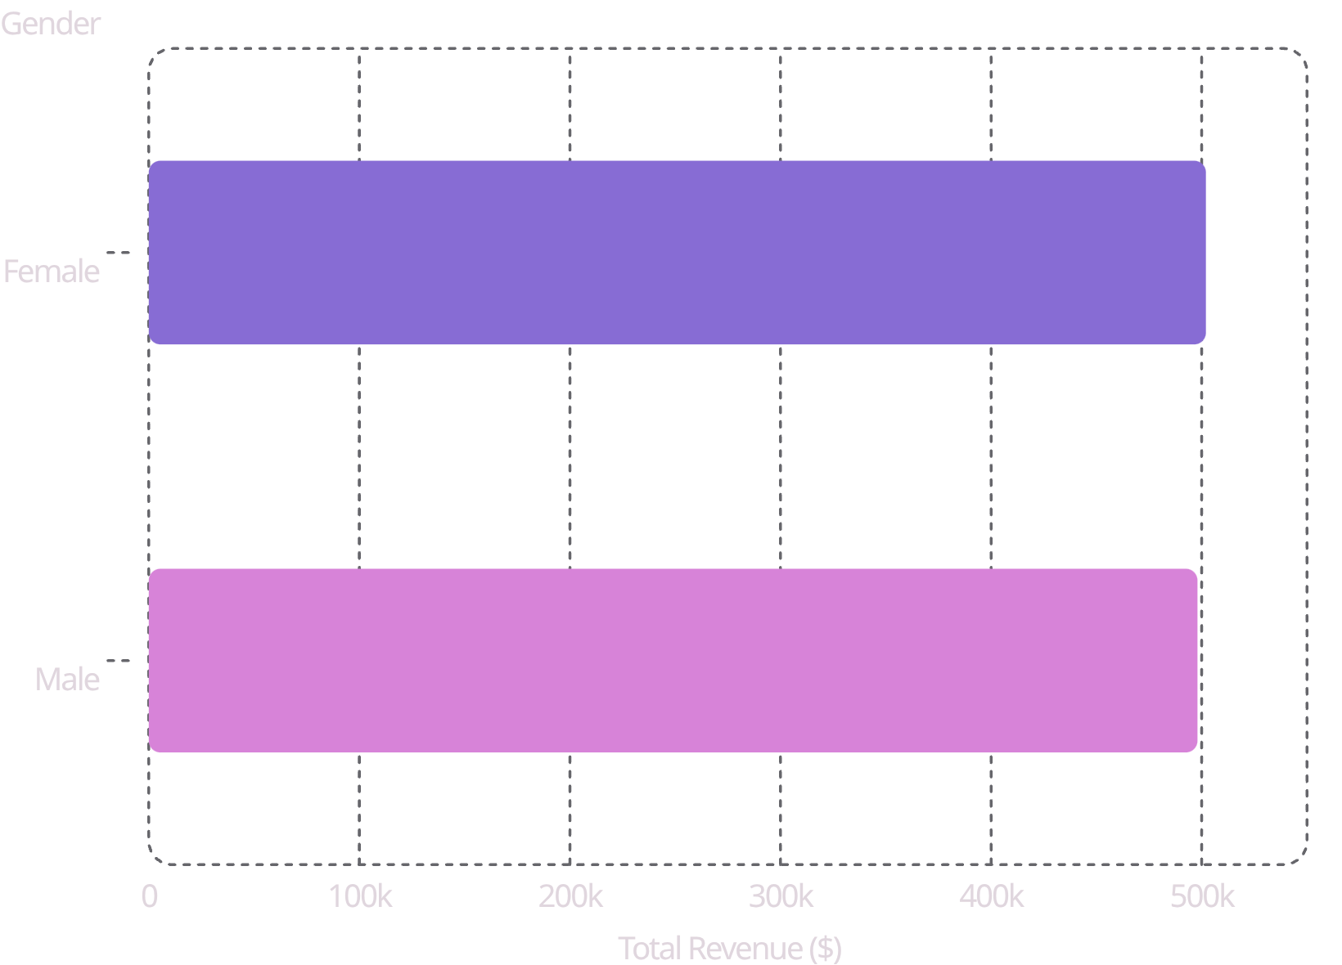
Revenue by Gender Analysis
Key Insight
Female customers generate slightly higher total revenue than male customers across the dataset. The gap is narrow but consistent.
Gender-based marketing strategies — including personalized promotions and product recommendations — could further optimize revenue streams for each segment.

Slide 5

High-Value Discount Users
Customers who use discounts and spend above average represent a uniquely valuable segment — they are deal-savvy without being low-value.
Smart Shoppers
High spenders who strategically maximize value with discounts — loyal, engaged, and revenue-positive.
Strategic Opportunity
Target premium customers with exclusive, members-only offers to reinforce loyalty and increase purchase frequency.

Slide 6

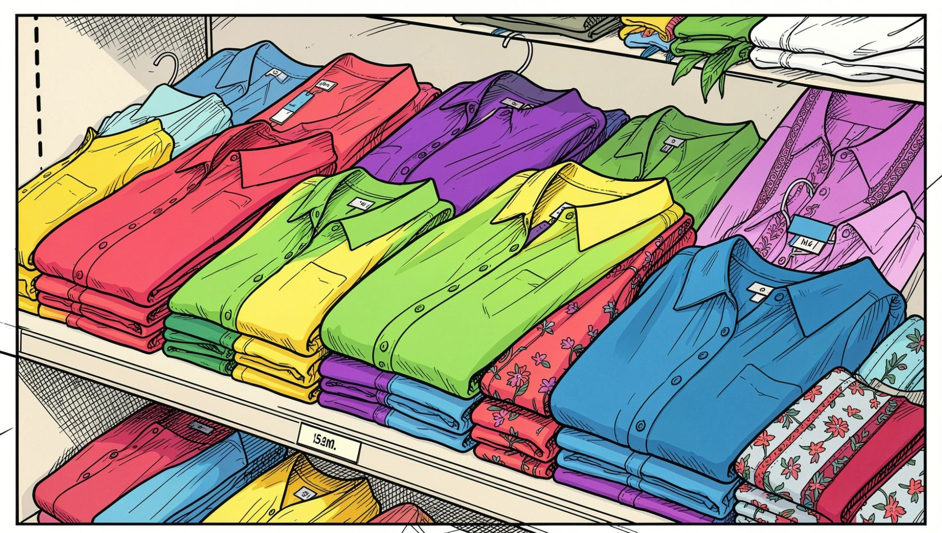

Top-Rated Products
⭐ Blouse
Highest customer satisfaction — consistently excellent reviews across all demographics
⭐ Dress
Strong customer approval with high repeat-purchase intent
⭐ Shirt
Reliably well-reviewed across price points and seasons

Slide 7
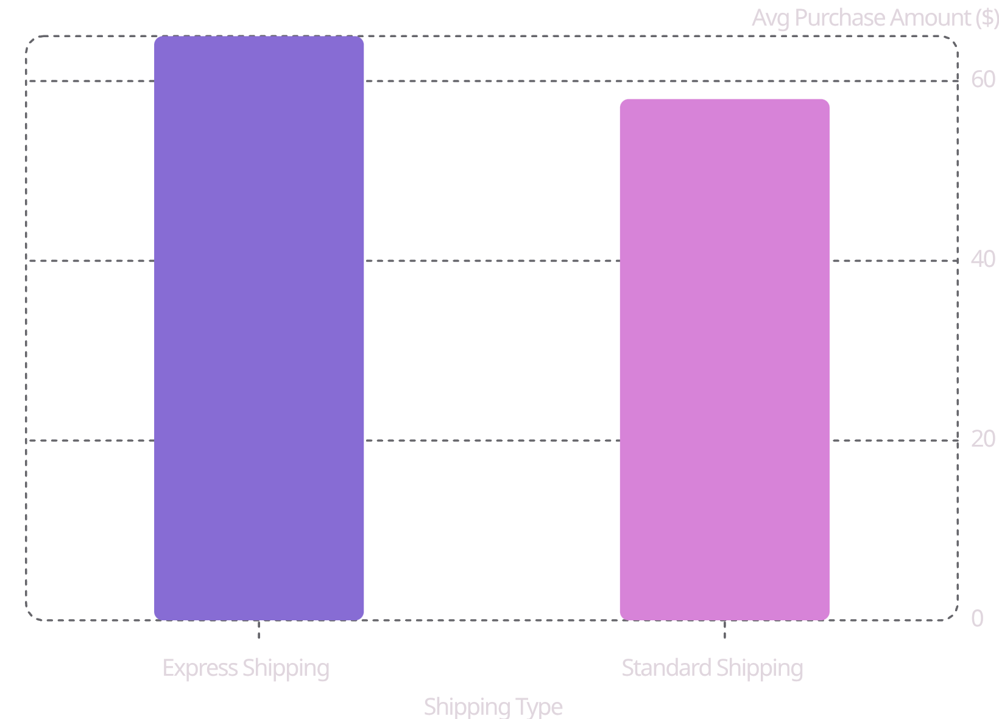
Shipping Preferences Impact
Express Customers Spend More
Customers who choose Express Shipping spend an average of $65 per transaction — 12% more than Standard Shipping customers at $58.
Shipping preference is a strong behavioral signal. Prioritize express-eligible promotions and upsells to this high-intent segment.

Slide 8

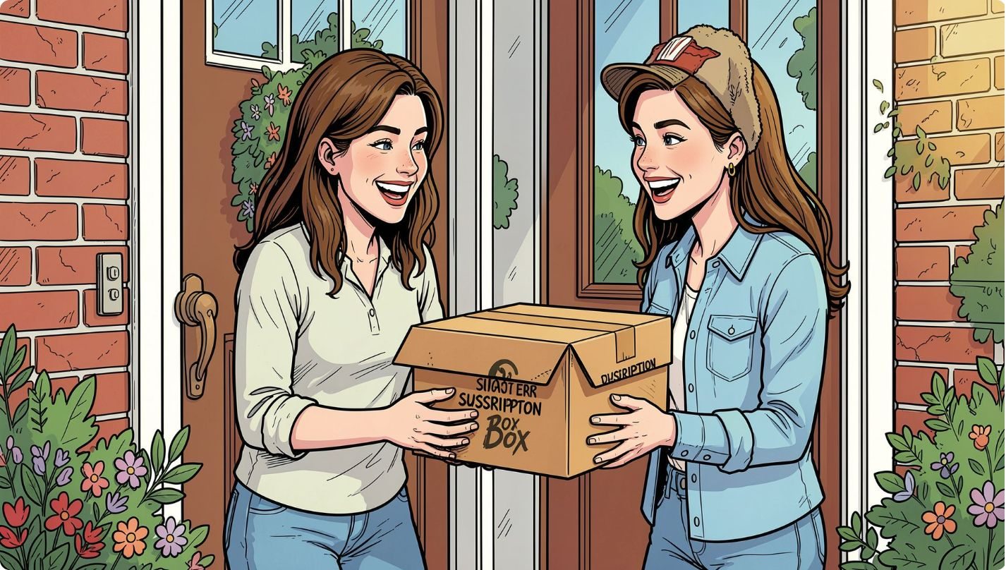



Subscription Impact
Higher Spend
Subscribers consistently outspend non-subscribers per transaction
Revenue Share
A disproportionate share of total revenue comes from subscription customers
Loyalty Rate
Subscribers demonstrate significantly higher repeat purchase frequency
Subscriptions are a powerful lever for both revenue growth and customer retention.

Slide 9
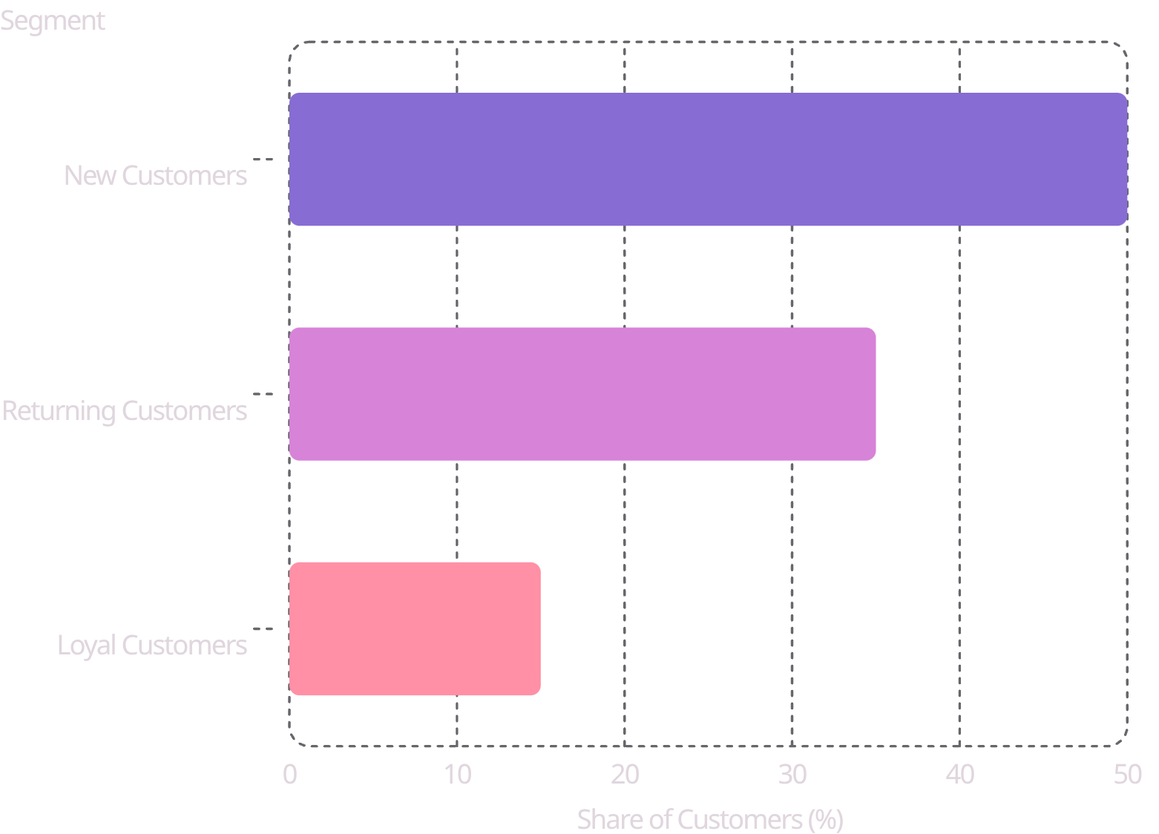

Customer Segmentation
Three Tiers of Value
Half the customer base are first-time buyers — the largest growth opportunity lies in converting them up the loyalty ladder.
New → Returning
Returning → Loyal
Welcome sequences and first-purchase incentives
Points programs and personalized rewards

Slide 10





Strategic Recommendations
Boost Subscriptions
Promote exclusive subscriber benefits — free shipping, early access, and member pricing.
Loyalty Programs
Reward repeat buyers with points, tiers, and personalized perks to increase retention.
Targeted Marketing
Focus spend on high-revenue segments — female shoppers, express users, and subscribers.
Product Positioning
Feature top-rated items (Blouse, Dress, Shirt) prominently in campaigns and homepage placements.

